Slide 1
19CSE303-Introduction to Embedded System

Slide 2
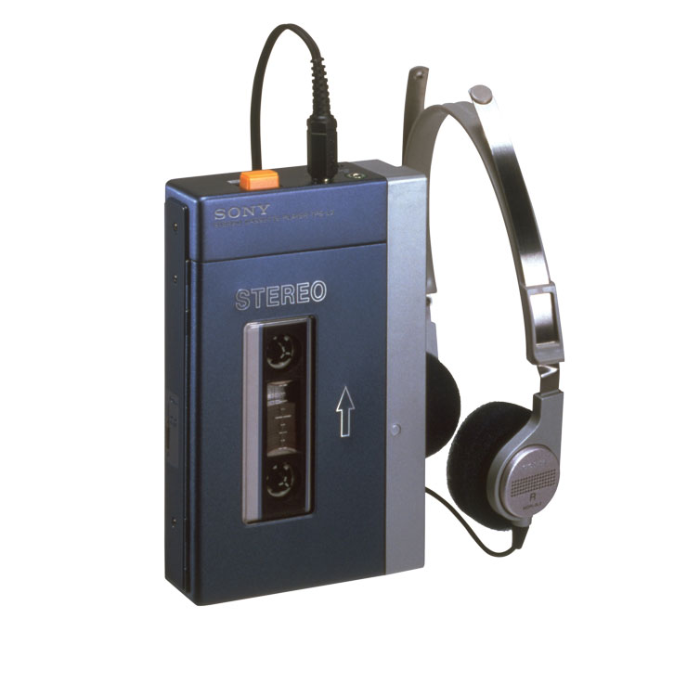
Walkman cassette-based

Slide 3
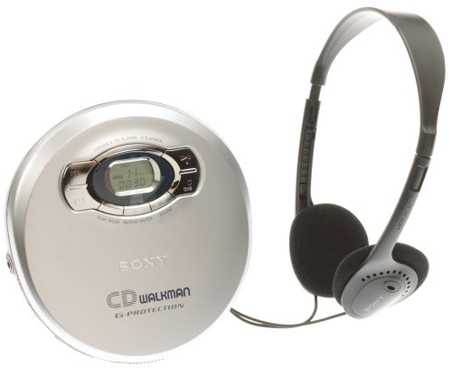
CD
Walkman

Slide 4
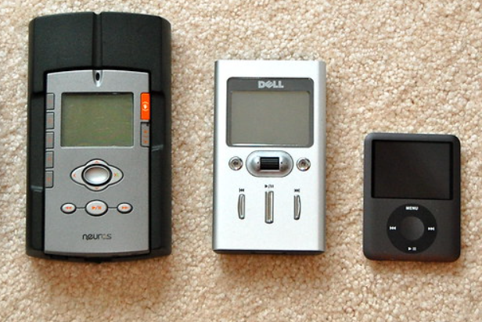
Digital Audio Players

Slide 5
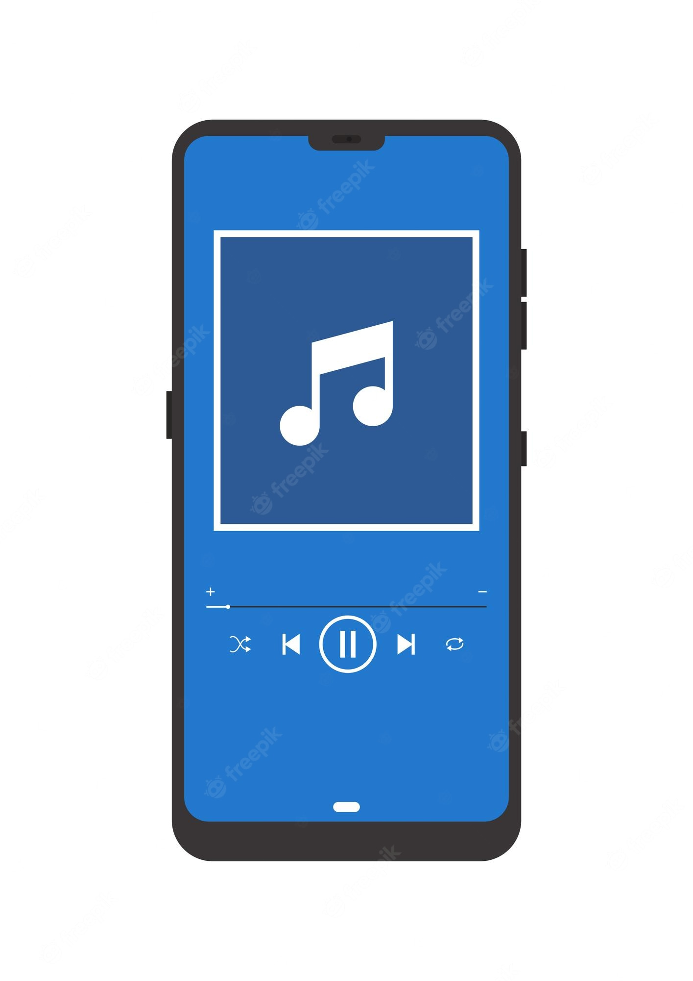
Smartphones and Convergence

Slide 6


Slide 7
What is an Embedded System?
An embedded system is a combination of computer hardware and software designed for a specific function.
An embedded system is a microprocessor-based computer hardware system with software that is designed to perform a dedicated function, either as an independent system or as a part of a large system.
An embedded system is a microcontroller or microprocessor based system which is designed to perform a specific task

Slide 8
Common Features of Embedded Systems
Designed to perform specific repeated functions on certain single-purpose devices
Should perform their functions quickly, sometimes within a prescribed timeframe
Based on microprocessors and microcontrollers
May work without operating systems or use special OSs, quite often real-time operating systems (RTOS)
Microcontrollers do not have an Operating System (OS) like Windows or macOS permanently inside them. But for complex projects, you can manually install a specialized, lightweight OS called a Real-Time Operating System (RTOS).
A microcontroller runs a program without an operating system by executing machine-code instructions directly from its non-volatile Flash memory.
Work with limited memory, power and computing resources
May or may not have a keyboard, screen, user interface, connectivity

Slide 9
Microcontroller
A microcontroller is essentially a tiny, self-contained computer on a single integrated circuit (IC). It packs a processing core, memory, and programmable inputs/outputs directly onto the silicon chip, while relying on the surrounding printed circuit board (PCB) for power regulation, connectivity, and external hardware interfaces.
Examples
  ESP32
  Arduino Uno contains the brain (Microcontroller) and the body (Development Board) - it is a complete, open-source microcontroller development board

Slide 10
Microcontroller
Components Within the Microcontroller Chip
Everything required to compute and execute logic is fabricated directly onto the silicon die itself.
CPU (Central Processing Unit): The "brain" of the chip that retrieves instructions, decodes them, and performs the necessary math and logic via its internal Arithmetic Logic Unit (ALU) and Control Unit (CU). Generally it contains the arithmetic logic unit and the registers, stack pointer, program counter, accumulator register, register file, etc.
Memory Units:
  Flash / ROM: Non-volatile memory used to store the actual code (firmware), which is retained even when power is turned off. (Program Memory)
  RAM: Volatile memory (Static RAM or SRAM) used to store temporary variables and data while the chip is actively running. (Data Memory)
  EEPROM: Optional non-volatile memory for storing small amounts of data that need to be saved even after a power cycle.
  Clock / Oscillator Circuit: Generates the precise timing pulses (or cycles) that govern the speed and synchronization of the processor.

Slide 11
Microcontroller
Components Within the Microcontroller Chip
System Peripherals:
  GPIOs (General Purpose Input/Output): The physical pins on the chip used to read signals from sensors or send signals to actuators.
  Timers/Counters: Used to keep track of time, measure events, or trigger actions at exact intervals.
  Communication Interfaces: Built-in hardware for talking to other chips, such as UART, SPI, I2C, and USB.
  ADCs (Analog-to-Digital Converters): Converts real-world analog signals (e.g., from a temperature sensor) into digital numbers the CPU can read.

Slide 12
Microcontroller
Components On-Board (The Circuit Board)
Because the microcontroller chip cannot do everything alone, the surrounding circuit board (the development or embedded board) hosts the supplementary hardware required for the system to function safely and interact with the physical world.
Power Management:
  Voltage Regulator (LDO): Steps down external power (like 5V from USB) to the safe operating voltage required by the microcontroller (typically 3.3V).
  Decapacitors: Small capacitors placed around the board to smooth out voltage ripples and filter electrical noise.
Timing & Resonators:
  External Crystal Oscillator: While some chips have internal clocks, many boards include an external quartz crystal for extreme timing precision (required for complex protocols like USB or Ethernet).
Connectivity & Interfaces:
  USB/Ethernet Ports: Physical connectors that allow the board to communicate with a computer, load firmware, or network.
  Headers & Connectors: The pin slots/sockets where you plug in jumper wires, sensors, and external modules.
User Interfaces:
  LEDs: Usually a power indicator and user-programmable LEDs for testing.
  Push Buttons: Typically used as a master Reset button or as a general-purpose user input.

Slide 13
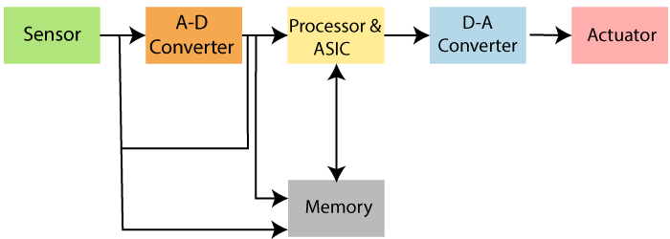
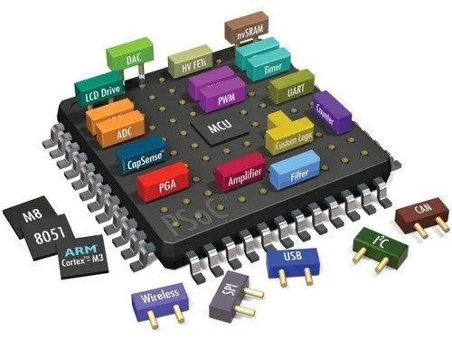
Basic Structure of an Embedded System
An application-specific integrated circuit (ASIC /ˈeɪsɪk/) is an integrated circuit (IC) chip customized for a particular use, rather than intended for general-purpose use, such as a chip designed to run in a digital voice recorder or a high-efficiency video codec.

Slide 14
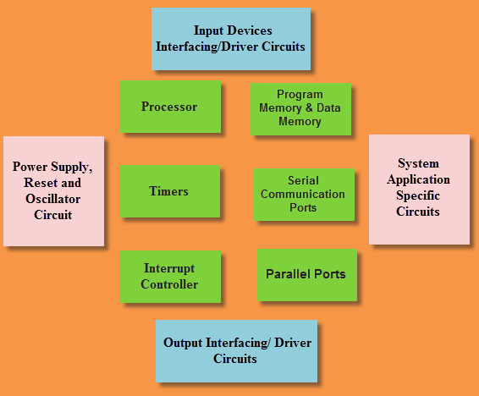
Basic Structure of an Embedded System

Slide 15
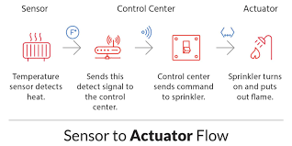
Basic Structure of an Embedded System
memory devices for data storage
I/O devices for input and output operations
computer buses for transferring data between hardware components
sensors for converting physical data into analog electrical signals
analog-to-digital converters (ADC) for transforming analog electrical signals (e.g. sound or light) into digital ones that the processor can read
digital-to-analog converters (DAC) for transforming digital signals from the processor into electrical ones
actuators for making mechanisms function based on the signal from the processor, for example, making a motor move
peripherals (cameras, printers, scanners, keyboards, etc.).

Slide 16
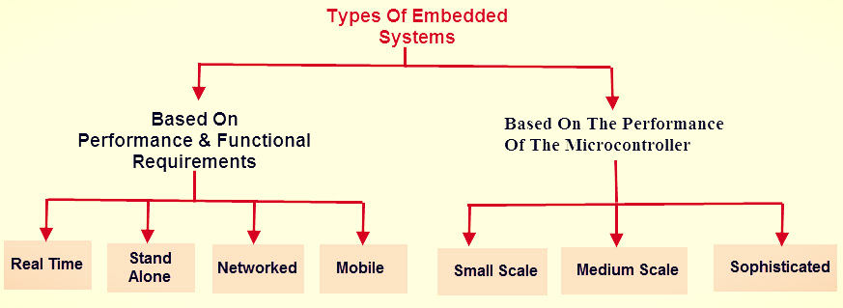
Type of Embedded System

Slide 17
Type of Embedded System
Real-time embedded system:
Real-time systems are those which give a quick response to critical situations. They are used in military, medical and industrial applications.
  Radio, satellite and telephone communication
  Patient monitoring system
Standalone embedded system:
This type of embedded system works for itself as a device without needing any interconnected computer. It can take data in the form of analog or digital signals. This system first process data and then outputs data by displaying on the screen.
  Microwave ovens
  Digital cameras
Networked embedded system:
Networked embedded systems are those systems which are connected to the network to give output to the attached resources.
  In office security system, different sensors (light sensors, smoke sensors or motion detectors) are networked together through LAN and controlled over the WAN (internet)

Slide 18
Type of Embedded System
Mobile embedded system:
Mobile embedded systems are limited in resources including memory.
  Cellular phones
  Mp3 players
  Digital cameras
Small-scale embedded system:
Small-scale embedded systems consist of 8-16 bit microcontroller. This system can perform tasks at a small level. They have on-chip ROM and RAM. Small-scale systems can be even activated by the battery.

Slide 19
Type of Embedded System
Medium scale embedded system:
This embedded system has 16-32 bit microprocessor or microcontroller with external RAM and ROM They can perform medium to complex level works. The integration between hardware and software is complex in these embedded systems. Programming languages used to develop medium scale embedded systems include Java, C, Visual C++.
Sophisticated embedded system:
The embedded system which can do large-scale works with multiple 32-64 bit chips is known as sophisticated embedded systems. They can perform distributed work on a large scale. The complexity of hardware and software is very high in these systems.

Slide 20
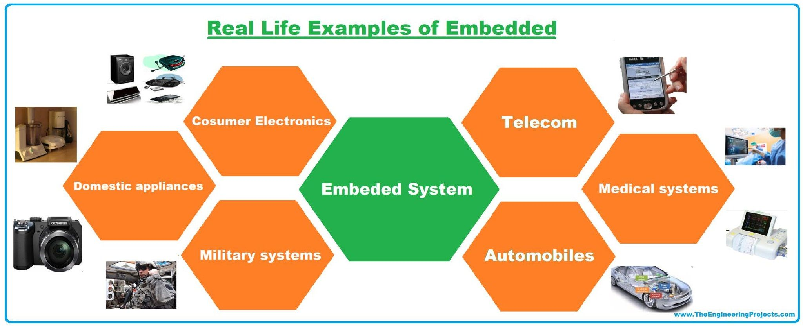

Slide 21
Applications of Embedded Systems
Embedded Systems in Automobiles and in telecommunications
  Motor and cruise control system
  Body or Engine safety
  Entertainment and multimedia in car
  Robotics in assembly line
  Wireless communication
  Mobile computing and networking
Embedded Systems in Smart Cards, Missiles and Satellites
  Security systems
  Telephone and banking
  Defense and aerospace
  Communication

Slide 22
Applications of Embedded Systems
Embedded Systems in Peripherals & Computer Networking
  Displays and Monitors
  Networking Systems
  Image Processing
  Network cards and printers
Embedded Systems in Consumer Electronics
  Digital Cameras
  Set top Boxes
  High Definition TVs
  DVDs

Slide 23
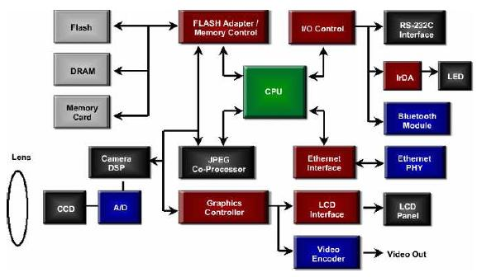
An Example Embedded System
(Digital Camera Block Diagram)
Digital Camera Block Diagram

Slide 24
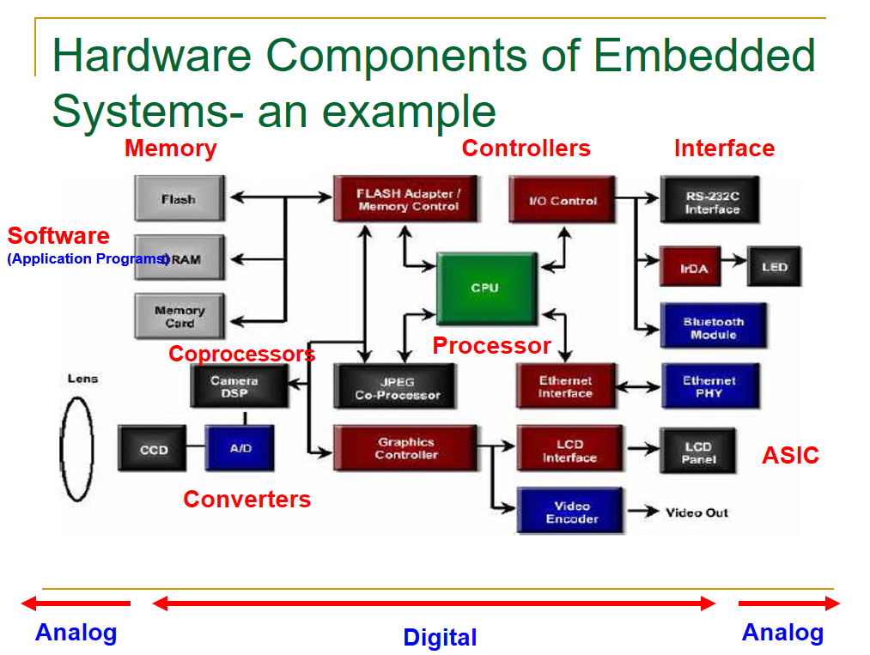

Slide 25
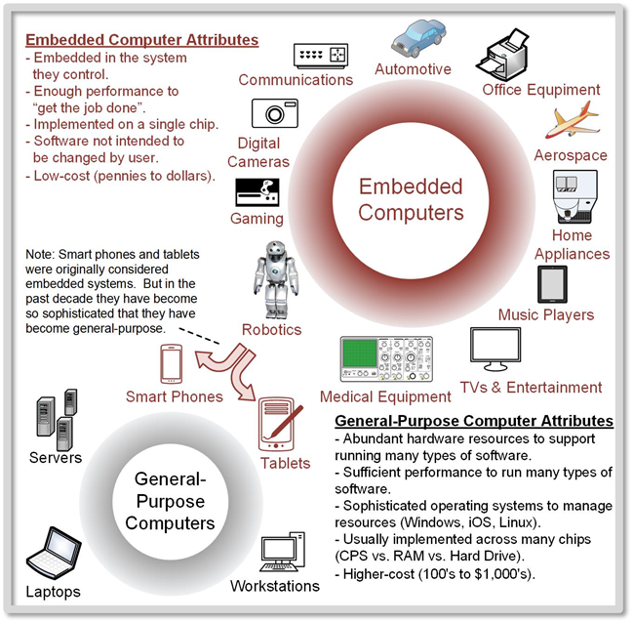


Slide 26
Thank you

